Slide 1
DMTF Cloud Standards
Cloud Management & OVF Update to ITU-T SG13

Slide 2
Disclaimer
The information in this presentation represents a snapshot of work in progress within the DMTF.
This information is subject to change. The Standard Specifications remain the normative reference for all information.
For additional information, see the Distributed Management Task Force (DMTF) Web site:
www.dmtf.org
Cloud work at DMTF
http://www.dmtf.org/standards/cloud
Work in Progress documents available at:
http://www.dmtf.org/standards/wip

Slide 3
Contents
Management Cake
Cloud Management Work Group (CIMI)
Open Virtualization Format Work Group (OVF)
Cloud Auditing Data Federation Work Group (CADF)
Software Entitlement Work Group (SEWG)

Slide 4
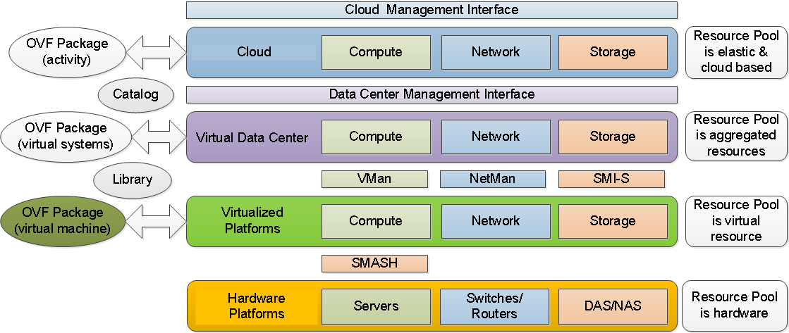
Management Cake

Slide 5
Cloud Management Work Group
Cloud Infrastructure Management Interface Model and RESTful HTTP-based Protocol (CIMI) DSP0263
Version 1 approved at ISO
Version 2 in development
Version 2 Work Items
Collections architecture
Common network model
Work with NSM and OVF Work Groups
Input from NFV folks
Input from OpenStack
Version 2.1 Work Items
Use cases presented in “Cloud Infrastructure Management Interface Use Cases for CIMI 2Informational” DSP2042
Both DSP0263 v2 and DSP2042 available as work in progress

Slide 6
CIMI v2 Use Cases
Business Continuity/Disaster Recovery Use Cases
Realizing Business Continuity on a Machine
Realizing Disaster Recovery on a Machine
Service Level Objective Management Use Cases
Introducing SLO Concepts in CIMI
Assigning a Common SLO to a Machine in Multiple Clouds
Auto-scaling Functionality
Log and Metadata Management Use Cases
Authorization Metadata Management
Log Data Management
Aligning Monitoring and Auditing with CADF
Multi-cloud Management Use Cases
Support for Multiple Operations in One Job

Slide 7
CIMI v2 Use Cases - continued
Federation and Multi-brokering
Controlling Resource Placement within a Cloud or across Clouds
Extending an Existing Network to Multiple Clouds
Creating an Inter-cloud Network
Multi-cloud System Configuration
Assigning a Common SLO to a Machine in Multiple clouds
OVF Life Cycle - Import
OVF Life Cycle - Export
Resource Groups Management and Control Use Cases
Support for Multiple Operations in One Job
Auto-scaling Functionality
Application Management and Orchestration Use Cases
Enabling Application-level Orchestration and Management

Slide 8
OVF 2
Submitted to ANSI / INCITS for de jure standard
Follow on submission to ISO/IEC for international standard
Feature set
Support for Network Port Profiles
Scaling at deployment time
Support for basic placement policies – including scoped placement
Encryption of OVF packages
Disk sharing at runtime
Advanced device boot order
Advanced data transfer to guest software
Improved support for Internationalization - I18N
Improved support of HASH functions
Enhanced shutdown order control

Slide 9
OVF 3
OVF 3 is in development
Focus on network abstraction for cloud customer deployment
Focus on virtual network devices to address ETSI NFV use cases
Focus on shared information network model for with CIMI and Network Services Management

Slide 10
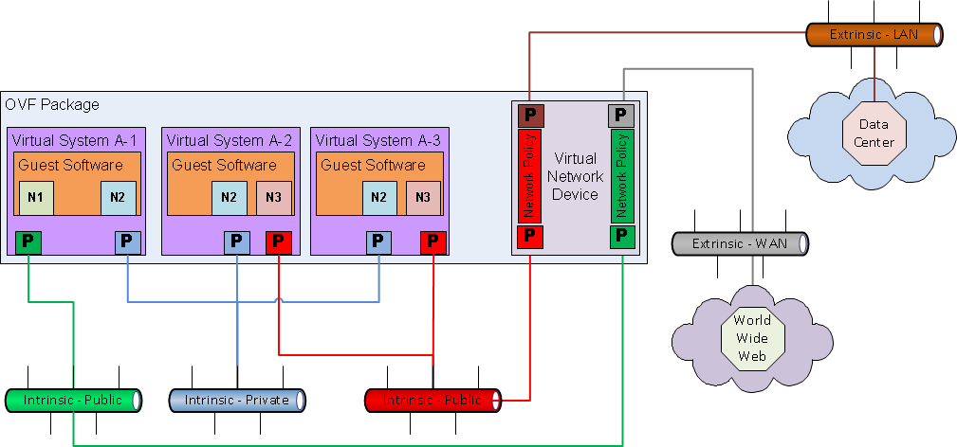
OVF and Virtual Network Devices

Slide 11
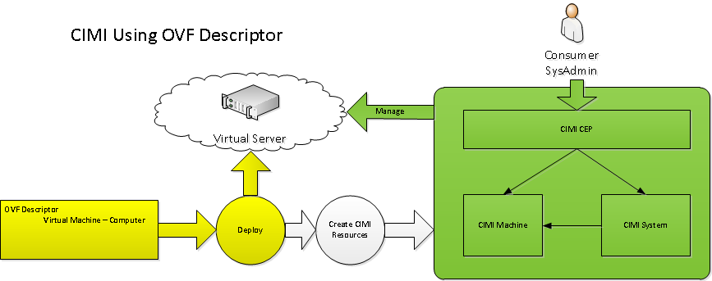
OVF and CIMI

Slide 12
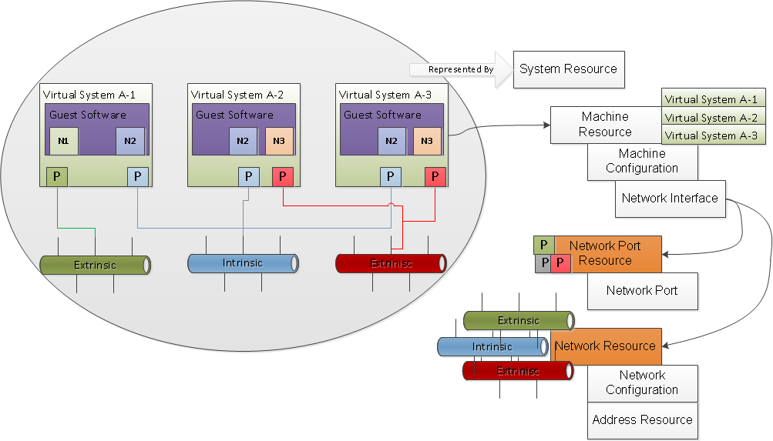
OVF Translation to CIMI Resources

Slide 13
Cloud Auditing Data Federation Work Group
Develop Standards for the Federation of Cloud Audit Data
Specify Data Model with a Normative, Prescriptive Audit Event Data Format
Deterministic values and fields (no Empty or Null fields)
Along with Interface Definitions and a compatible Component and Interaction Model
Supported by Granular Use Cases Covering Various Compliance Areas
Key Consumers / Audience
Professionals Responsible for Certifying Compliance with IT, Industry, Government, Regional and Corporate Policies
e.g. Auditors, Chief Compliance Officer (CCO), Chief Risk Officer (CRO), Chief Info. Sec. Officer (CISO), CIO, CFO, etc.
CADF Projects
DSP0262 Data Format and Interface Definitions Specification
DSP2038 OpenStack Model (CADF-OpenStack), A CADF Representation for OpenStack

Slide 14
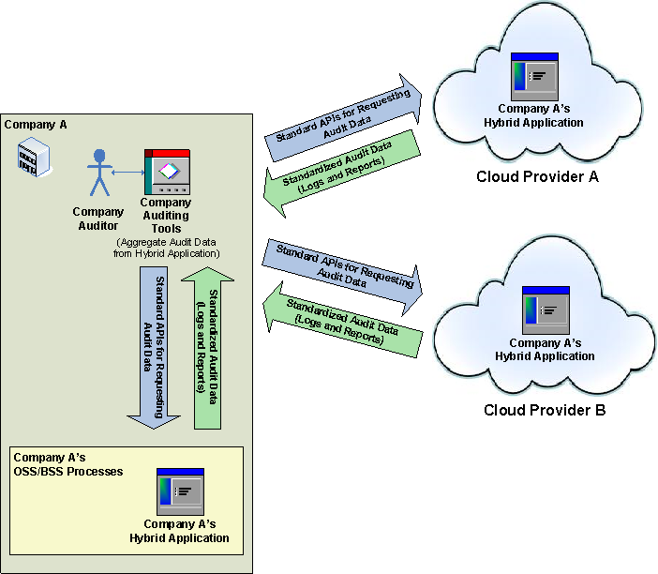
CADF – A Use Case
Aggregates Audit Data from
Hybrid Cloud Application
That Spans Multiple
(Cloud and Partner)
Deployments

Slide 15
Software Entitlement Work Group
List of Software Products whose entitlement metrics can be managed
Product - unit of acquisition, primary access point for manageability.
Product Identification
Entitlement Usage Metrics
Events on a per Product basis
For the key events in the product lifecycle, events and relevant statistics are accumulated
Software Entitlement Projects
DSP1067 Software ID Tag Profile (work in progress release)
DSP IS0301 Software Identification and Entitlement Metrics
Aligned with ISO/IEC 19770-3, Information technology — Software asset management — Part 3: Software entitlement tag

Slide 16
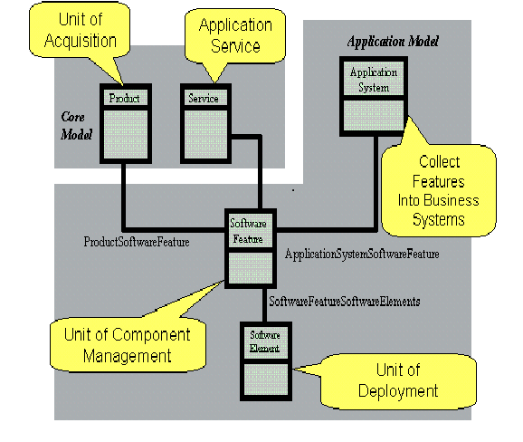
SE - Model

