Slide 1
2025 Manageability Workshop Presented by DMTF at OCP Global Summit Enhancements to PLDM for Firmware Update
Patrick Caporale, Lenovo
Yuval Itkin, NVIDIA
October 2025

Slide 2
Disclaimer
The information in this presentation represents a snapshot of work in progress within the DMTF.
This information is subject to change without notice. The standard specifications remain the normative reference for all information.
For additional information, see the DMTF website.
This information is a summary of the information that will appear in the specifications. See the specifications for further details

Slide 3
Agenda
Background – PLDM for Firmware Update
How does it work?
Feature enhancements to date
What comes next?
How to get involved
Goals of this Presentation
Provide an overview of PLDM for Firmware Update
Discuss existing enhancements and futures for the standard

Slide 4
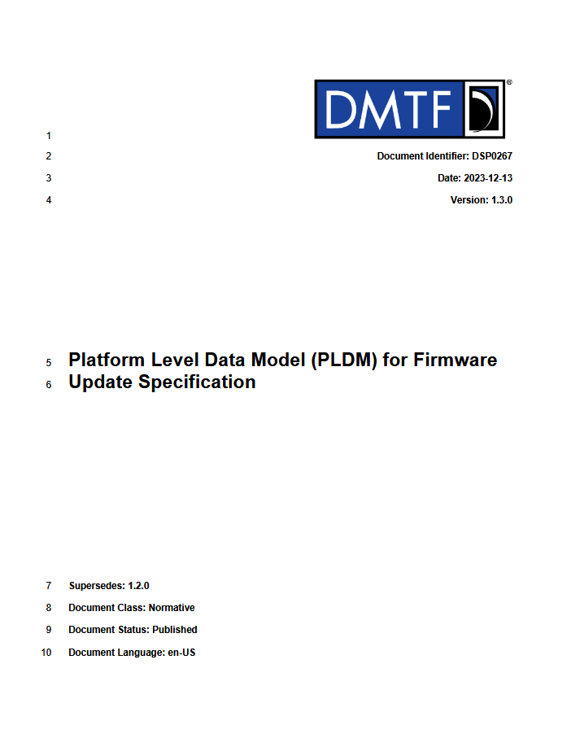
Background - PLDM For Firmware Update
PLDM = Platform Level Data Model
Initially released in 2016 -- almost 10 years of implementations!
Supports FW updates across a wide range of device types
Base Capabilities:
Obtaining current & pending firmware version details
Transferring a new code image to the device
A consistent packaging format (includes both header and images)
Update Agent can be enabled with vendor agnostic code
Typically resides in the MC (BMC) of a platform
DSP0267
PLDM for Firmware Update = DSP0267
Additional PLDM specifications at www.dmtf.org/standards/pmci

Slide 5
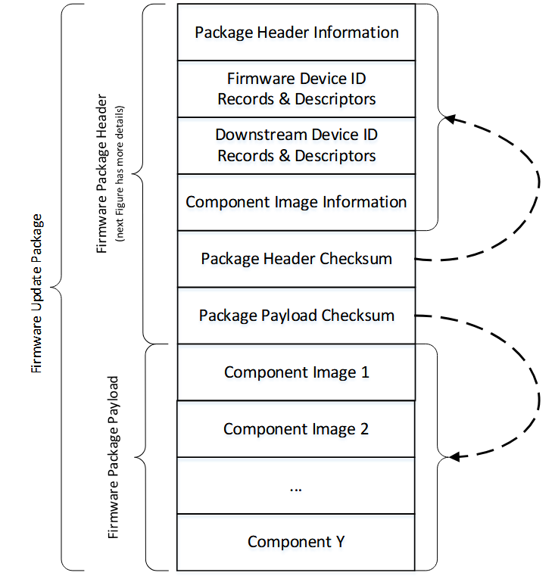
How does it work? (High Level)
PLDM is a messaging layer that can be sent over multiple transports
MCTP is a common transport implementation for PLDM
MCTP can communication over a variety of physical interfaces
PCIe VDM, I2C/I3C, USB, etc
Update Agent (UA) can inventory Firmware Devices (FD) details
Gather information on how many code images, version, capabilities, etc
Can be accessed independent from the ‘update’ operation
Details on the FD capabilities both during and post update can be discovered
For new code updates, the UA is provided a PLDM FW Update Package
Details relevant to just the UA are in the header of the package
List of descriptors to identify which type device the images are compatible
Capabilities of the image during and post update (activation methods, etc)
Can contain optional opaque data which is passed to the FD
Firmware Update Package

Slide 6
How does it work? (High Level) – Cont.
3
The UA initiates the update via a request command
Subsequent steps between the UA and FD follow a well-defined state machine
The image is ‘pulled’ by the FD in a manner that is needed by the device
1) Idle State
2) Learn Components
2
3) Ready XFER
+Download/Verify/Apply
(multiple times if needed)
Activation
Multiple choices for how the new image can become the running image
“Self-Contained” activation
Delayed activation
Activation on next reset
Which methods are supported is dependent on capabilities of the specific device type
4
5
1
4) Activate
5) Back to Idle
Firmware Device State Machine

Slide 7
Feature additions through v1.3 (current release)
v1.1 (2019) – Added support for Downstream devices, added delayed activation
These are endpoints that are not directly accessible via PLDM (example a disk drive)
Another device can proxy on behalf of the downstream device
Enhanced ‘self-contained’ activation to allow the UA to request activation at a later time
v1.2 (2022) – Enhanced state machine support and security revision tracking
Enabled more use cases with devices that need opaque data sent to it during the update
Added additional status capabilities (both success and error states)
Allows the FD to identify a security revision for its code images which prevents downgrade
v1.3 (2023) – Add Manifest Data to the PLDM Package, add Individual Device Packaging
Allows the inclusion of a Standards Body or Vendor Defined Header (SVH) in the package
Data formats are set by organizations (TCG, standards orgs, etc)
Individual device packaging allows for a device vendor to provide an image intended to be incorporated into a larger PLDM package (ie system level update)

Slide 8
What comes next? 1.4 Preview
Continue enhancements for latest devices types (accelerators, new interconnect devices, etc)
Additional inventory capabilities
Enhancements to the state machine for additional use cases around error handling and recovery
Activation methods enhancements
Allowing more awareness between the UA and FD on how/when activation can occur
A new ‘Push’ model to deploy the code image
Major update to 1.4
Will provide an optional capability where the image can be transferred from the UA to the FD
Opposite of current method
Will be an option that can be supported by the UA and FD
Does not change/affect the current transfer method for devices that still use it
Can be a benefit to small/lightweight devices that want to just have an image passed to it sequentially
Allows FW update to be performed over multiplexed buses such as I2C/SMBus

Slide 9
How to get involved
Contribute to the PLDM For Firmware Update specifications
Intent is to continue enhancements to provide the industry with a vendor/device type agnostic update method
Ensure features/capabilities of new technologies can be updated via PLDM
Direct through the PMCI Workgroup Group of DMTF
https://www.dmtf.org/standards/pmci
Or
DMTF Feedback Portal
https://www.dmtf.org/standards/feedback

Slide 10
Acknowledgement
Thanks to all the contributors and participants of the PMCI Working Group!

Slide 11
Questions?

Slide 12
For more information, visit dmtf.org Learn about the PMCI working group at dmtf.org/standards/pmci
Thank you!

